Slide 1
SQL – DATA DEFINITION (1)
Course : ISYS6280 – Database Systems (GAT)
Year : 2015
Session 2

Slide 2
LEARNING OUTCOME
LO 2 : Apply database language and SQL Programming language

Slide 3
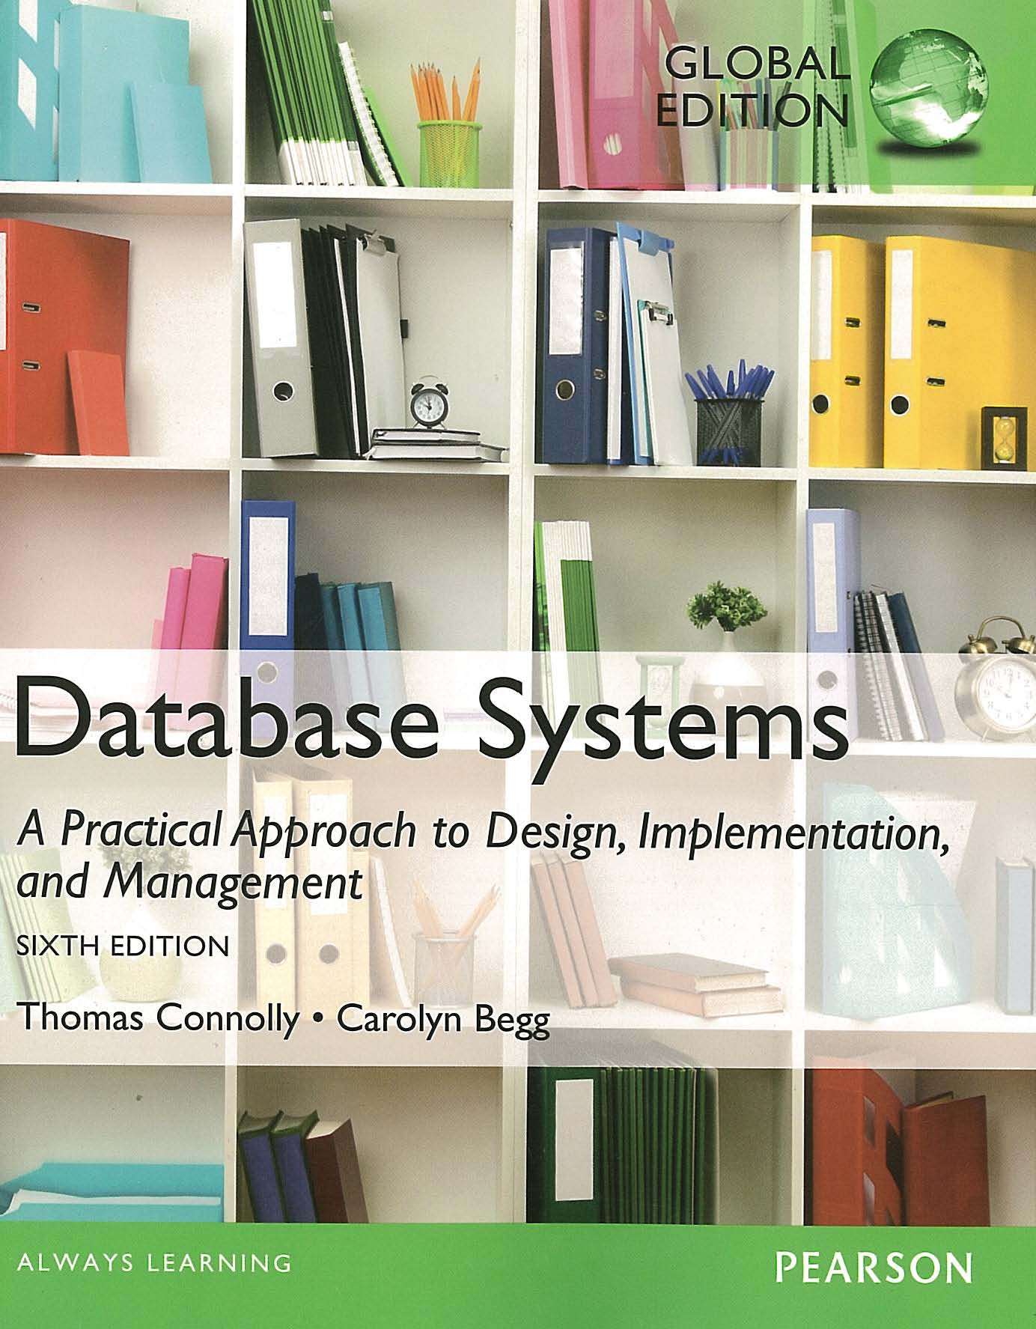
ACKNOWLEDGEMENT
These slides have been adapted from Thomas Connolly and Carolyn Begg. 2015. Database Systems: A Practical Approach To Design, Implementation, and Management. Pearson Education. USA. ISBN:978-1-292-06118-4

Slide 4
CHAPTER 7 SQL : DATA DEFINITION

Slide 5

LEARNING OBJECTIVES-CHAPTER 7
Purpose and importance of SQL
Data types supported by SQL standard.
Purpose of integrity enhancement feature of SQL.
How to define integrity constraints using SQL.
How to use the integrity enhancement feature in the CREATE and ALTER TABLE statements.
vtraining-msuhandi.blogspot.com

Slide 6
Objectives of SQL
Ideally, database language should allow user to:
create the database and relation structures;
perform insertion, modification, deletion of data from relations;
perform simple and complex queries.
Must perform these tasks with minimal user effort and command structure/syntax must be easy to learn.
It must be portable.
SQL is a transform-oriented language with 2 major components:
A DDL for defining database structure.
A DML for retrieving and updating data.

Slide 7
Objectives of SQL
Until SQL:1999, SQL did not contain flow of control commands. These had to be implemented using a programming or job-control language, or interactively by the decisions of user.
SQL is relatively easy to learn:
it is non-procedural - you specify what information you require, rather than how to get it;
it is essentially free-format.
Can be used by range of users including DBAs, management, application developers, and other types of end users.
An ISO standard now exists for SQL, making it both the formal and de facto standard language for relational databases.

Slide 8
Objectives of SQL
Consists of standard English words:
1) CREATE TABLE Staff(staffNo VARCHAR(5),
lName VARCHAR(15),
salary DECIMAL(7,2));
2) INSERT INTO Staff VALUES (‘SG16’, ‘Brown’, 8300);
3) SELECT staffNo, lName, salary
FROM Staff
WHERE salary > 10000;

Slide 9

History of SQL
In 1974, D. Chamberlin (IBM San Jose Laboratory) defined language called ‘Structured English Query Language’ (SEQUEL).
A revised version, SEQUEL/2, was defined in 1976 but name was subsequently changed to SQL for legal reasons.
Still pronounced ‘see-quel’, though official pronunciation is ‘S-Q-L’.
IBM subsequently produced a prototype DBMS called System R, based on SEQUEL/2.
Roots of SQL, however, are in SQUARE (Specifying Queries as Relational Expressions), which predates System R project.
historyarthistory.gmu.edu

Slide 10

History of SQL
In late 70s, ORACLE appeared and was probably first commercial RDBMS based on SQL.
In 1987, ANSI and ISO published an initial standard for SQL.
In 1989, ISO published an addendum that defined an ‘Integrity Enhancement Feature’.
In 1992, first major revision to ISO standard occurred, referred to as SQL2 or SQL/92.
In 1999, SQL:1999 was released with support for object-oriented data management.
In late 2003, SQL:2003 was released.
In summer 2008, SQL:2008 was released.
In late 2011, SQL:2011 was released.
kiossoftware.com

Slide 11
Importance of SQL
SQL has become part of application architectures such as IBM’s Systems Application Architecture.
It is strategic choice of many large and influential organizations (e.g. X/OPEN).
SQL is Federal Information Processing Standard (FIPS) to which conformance is required for all sales of databases to American Government.
SQL is used in other standards and even influences development of other standards as a definitional tool. Examples include:
ISO’s Information Resource Directory System (IRDS) Standard
Remote Data Access (RDA) Standard.

Slide 12
Writing SQL Commands
SQL statement consists of reserved words and user-defined words.
Reserved words are a fixed part of SQL and must be spelt exactly as required and cannot be split across lines.
User-defined words are made up by user and represent names of various database objects such as relations, columns, views.
Most components of an SQL statement are case insensitive, except for literal character data (for example: lastName 'SMITH' is different from 'Smith').
More readable with indentation and lineation:
Each clause should begin on a new line.
Start of a clause should line up with start of other clauses.
If clause has several parts, should each appear on a separate line and be indented under start of clause to show the relationship.

Slide 13
Writing SQL Commands
Use extended form of BNF notation:
- Upper-case letters represent reserved words.
- Lower-case letters represent user-defined words.
- A vertical bar ( | ) indicates a choice among alternatives; for example: a | b | c.
- Curly braces indicate a required element; for example: {a}.
- Square brackets indicate an optional element; for example: [a].
- An ellipsis (…) indicates optional repetition (0 or more). For example: {a|b}(,c...) means either a or b followed by zero or more repetitions of c separated by commas.

Slide 14
Literals
Literals are constants used in SQL statements.
All non-numeric literals must be enclosed in single quotes (e.g. ‘London’).
All numeric literals must not be enclosed in quotes (e.g. 650.00).

Slide 15
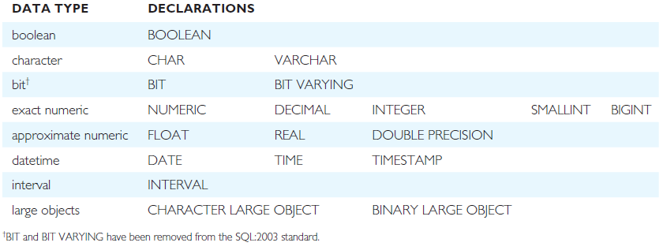
ISO SQL Data Types
^{CHAR: fixed length character}
VARCHAR: varying length character
^{NUMERIC[precision,[scale]]}
^{DECIMAL[precision,[scale]]}
^{The default scale is 0}
DECIMAL(6,2): can handle value up to 9,999.99

Slide 16
Integrity Enhancement Feature
Consider five types of integrity constraints:
required data (mandatory): attribute that must have a value (NOT NULL)
domain constraints: possible values for one/many attribute/s
entity integrity: Primary Key can’t have NULL value (NOT NULL) and must be unique
referential integrity: Foreign key has two types of possible values (1) NULL (if it is not mandatory) and (2) referred Primary Key values
general constraints: Enterprise Rules

Slide 17
Required Data
Required Data: Mandatory (the attribute must be filled with a value->NOT NULL)
CREATE TABLE STAFF
(
…
position VARCHAR(10) NOT NULL,
…
)

Slide 18
Domain Constraints
Domain Constraints
CHECK (Only used in one particular table)
Column Level
CREATE TABLE STAFF (
…
sex CHAR NOT NULL
CHECK (sex IN (‘M’, ‘F’)),
… )
Or
CREATE TABLE STAFF (
…
sex CHAR NOT NULL
CONSTRAINT C1 CHECK (sex IN (‘M’, ‘F’)),
… )

Slide 19
Domain Constraints
Domain Constraints
CHECK (Only used in one particular table)
Table Level
CREATE TABLE STAFF (
…
sex CHAR NOT NULL,
…
CHECK (sex IN (‘M’, ‘F’)),
… )
Or
CREATE TABLE STAFF (
…
sex CHAR NOT NULL,
…
CONSTRAINT C1 CHECK (sex IN (‘M’, ‘F’)),
… )

Slide 20
Domain Constraints
(b) CREATE DOMAIN (can be used in more than one table)
CREATE DOMAIN DomainName [AS] dataType
[DEFAULT defaultOption]
[CHECK (searchCondition)]
For example:
CREATE DOMAIN SexType AS CHAR
CHECK (VALUE IN (‘M’, ‘F’));
CREATE TABLE STAFF (
…
sex SexType NOT NULL,
… )

Slide 21
Domain Constraints
searchCondition can involve a table lookup:
CREATE DOMAIN BranchNo AS CHAR(4)
CHECK (VALUE IN (SELECT branchNo
FROM Branch));
Domains can be removed using DROP DOMAIN:
DROP DOMAIN DomainName
[RESTRICT | CASCADE]

Slide 22
IEF - Entity Integrity
Primary key of a table must contain a unique, non-null value for each row.
ISO standard supports PRIMARY KEY clause in CREATE and ALTER TABLE statements:
CREATE TABLE STAFF (
…
staffNo VARCHAR(5) PRIMARY KEY,
… )
Or
CREATE TABLE STAFF (
staffNo VARCHAR(5) NOT NULL,
…
PRIMARY KEY(staffNo),
… )

Slide 23
IEF - Entity Integrity
ISO standard supports PRIMARY KEY clause in CREATE and ALTER TABLE statements:
CREATE TABLE VIEWING (
clientNo VARCHAR(5) NOT NULL,
propertyNo VARCHAR(5) NOT NULL,
…
PRIMARY KEY(clientNo, propertyNo),
… )
Can only have one PRIMARY KEY clause per table. Can still ensure uniqueness for alternate keys using UNIQUE:
CREATE TABLE CLIENT (
…
UNIQUE(telNo),
… )

Slide 24
IEF - Referential Integrity
FK is column or set of columns that links each row in child table containing foreign FK to row of parent table containing matching PK.
Referential integrity means that, if FK contains a value, that value must refer to existing row in parent table.
ISO standard supports definition of FKs with FOREIGN KEY clause in CREATE and ALTER TABLE:
CREATE TABLE STAFF ( …
branchNo CHAR(4) REFERENCES Branch,
… )
Or
CREATE TABLE STAFF ( …
branchNo CHAR(4), …
FOREIGN KEY(branchNo) REFERENCES Branch
)

Slide 25
IEF - Referential Integrity
Any INSERT/UPDATE attempting to create FK value in child table without matching CK value in parent is rejected.
Action taken attempting to update/delete a CK value in parent table with matching rows in child is dependent on referential action specified using ON UPDATE and ON DELETE subclauses. For example referential action using ON DELETE :
CASCADE: Delete row from parent and delete matching rows in child, and so on in cascading manner.
SET NULL: Delete row from parent and set FK column(s) in child to NULL. Only valid if FK columns are NOT NULL (not mandatory).
SET DEFAULT: Delete row from parent and set each component of FK in child to specified default. Only valid if DEFAULT specified for FK columns.
NO ACTION: Reject delete from parent. Default.

Slide 26
IEF - Referential Integrity
ON UPDATE CASCADE:
Branch Staff
branchNo: B001 All Staff records with branchNo: B001
is updated into B011 are also updated into B011
ON UPDATE SET NULL:
Branch Staff
branchNo : B001 All Staff records with branchNo: B001
is updated into B011 are set to NULL value
ON DELETE CASCADE:
Branch Staff
branchNo : B001 All Staff records with branchNo: B001
This record is deleted are also deleted
ON DELETE SET NULL:
Branch Staff
branchNo : B001 All Staff records with branchNo: B001
This record is deleted are set to NULL value

Slide 27
IEF - Referential Integrity
FOREIGN KEY (staffNo) REFERENCES Staff ON DELETE SET NULL
FOREIGN KEY (ownerNo) REFERENCES Owner ON UPDATE CASCADE

Slide 28
IEF - General Constraints
Could use CHECK/UNIQUE in CREATE and ALTER TABLE.
Similar to the CHECK clause, also have:
CREATE ASSERTION AssertionName
CHECK (searchCondition)

Slide 29
IEF - General Constraints
CREATE ASSERTION StaffNotHandlingTooMuch
CHECK (NOT EXISTS (SELECT staffNo
FROM PropertyForRent
GROUP BY staffNo
HAVING COUNT(*) > 100))

Slide 30
Data Definition
SQL DDL allows database objects such as schemas, domains, tables, views, and indexes to be created and destroyed.
Main SQL DDL statements are:
CREATE SCHEMA DROP SCHEMA
CREATE/ALTER DOMAIN DROP DOMAIN
CREATE/ALTER TABLE DROP TABLE
CREATE VIEW DROP VIEW
Many DBMSs also provide:
CREATE INDEX DROP INDEX
CREATE INDEX Index_name ON Table_Name(Column1 [,column2,..])

Slide 31
Data Definition
Relations and other database objects exist in an environment.
Each environment contains one or more catalogs, and each catalog consists of set of schemas.
Schema is named collection of related database objects.
Objects in a schema can be tables, views, domains, assertions, collations, translations, and character sets. All have same owner.

Slide 32
CREATE SCHEMA
CREATE SCHEMA [Name |
AUTHORIZATION CreatorId ]
DROP SCHEMA Name [RESTRICT | CASCADE ]
With RESTRICT (default), schema must be empty or operation fails.
With CASCADE, operation cascades to drop all objects associated with schema in order defined above. If any of these operations fail, DROP SCHEMA fails.

Slide 33
CREATE TABLE
CREATE TABLE TableName
{(colName dataType [NOT NULL] [UNIQUE]
[DEFAULT defaultOption]
[CHECK searchCondition] [,...]}
[PRIMARY KEY (listOfColumns),]
{[UNIQUE (listOfColumns),] […,]}
{[FOREIGN KEY (listOfFKColumns)
REFERENCES ParentTableName [(listOfCKColumns)],
[ON UPDATE referentialAction]
[ON DELETE referentialAction ]] [,…]}
{[CHECK (searchCondition)] [,…] })

Slide 34

CREATE TABLE
Creates a table with one or more columns of the specified dataType.
With NOT NULL, system rejects any attempt to insert a null in the column.
Can specify a DEFAULT value for the column.
Primary keys should always be specified as NOT NULL.
FOREIGN KEY clause specifies FK along with the referential action.
www.zentut.com

Slide 35
Example 7.1 - CREATE TABLE
CREATE DOMAIN OwnerNumber AS VARCHAR(5)
CHECK (VALUE IN (SELECT ownerNo FROM PrivateOwner));
CREATE DOMAIN StaffNumber AS VARCHAR(5)
CHECK (VALUE IN (SELECT staffNo FROM Staff));
CREATE DOMAIN BranchNumber AS CHAR(4)
CHECK (VALUE IN (SELECT branchNo FROM Branch));
CREATE DOMAIN PropertyNumber AS VARCHAR(5);
CREATE DOMAIN DStreet AS VARCHAR(25);
CREATE DOMAIN DCity AS VARCHAR(15);
CREATE DOMAIN DPostCode AS VARCHAR(8);

Slide 36
Example 7.1 - CREATE TABLE
CREATE DOMAIN PropertyType AS CHAR(1)
CHECK(VALUE IN (‘B’,’C’,’D’,’E’,’F’,’M’,’S’));
CREATE DOMAIN PropertyRooms AS SMALLINT
CHECK(VALUE BETWEEN 1 AND 15);
CREATE DOMAIN PropertyRent AS DECIMAL(6,2)
CHECK(VALUE BETWEEN 0 AND 9999.99);

Slide 37
Example 7.1 - CREATE TABLE
CREATE TABLE PropertyForRent (
propertyNo PropertyNumber NOT NULL,
street DStreet NOT NULL,
city DCity NOT NULL,
postcode DPostCode,
type PropertyType NOT NULL DEFAULT ‘F’,
rooms PropertyRooms NOT NULL DEFAULT 4,
rent PropertyRent NOT NULL DEFAULT 600,
ownerNo OwnerNumber NOT NULL,
...

Slide 38
Example 7.1 - CREATE TABLE
…
staffNo StaffNumber
Constraint StaffNotHandlingTooMuch
CHECK (NOT EXISTS (SELECT staffNo
FROM PropertyForRent
GROUP BY staffNo
HAVING COUNT(*) > 100)),
branchNo BranchNumber NOT NULL,
PRIMARY KEY (propertyNo),
FOREIGN KEY (staffNo) REFERENCES Staff
ON DELETE SET NULL ON UPDATE CASCADE,
FOREIGN KEY (ownerNo) REFERENCES PrivateOwner
ON DELETE NO ACTION ON UPDATE CASCADE,
FOREIGN KEY (branchNo) REFERENCES Branch
ON DELETE NO ACTION ON UPDATE CASCADE
);

Slide 40
comment

Slide 41
ALTER TABLE
Add a new column to a table.
Drop a column from a table.
Add a new table constraint.
Drop a table constraint.
Set a default for a column.
Drop a default for a column.

Slide 42
Example 7.2(a) - ALTER TABLE
Change Staff table by removing default of ‘Assistant’ for position column and setting default for sex column to female (‘F’).
ALTER TABLE Staff
ALTER position DROP DEFAULT;
ALTER TABLE Staff
ALTER sex SET DEFAULT ‘F’;

Slide 43
Example 7.2(b) - ALTER TABLE
Remove constraint from PropertyForRent that staff are not allowed to handle more than 100 properties at a time.
ALTER TABLE PropertyForRent
DROP CONSTRAINT StaffNotHandlingTooMuch;
Add new column to Client table.
ALTER TABLE Client
ADD prefNoRooms PropertyRooms;

Slide 44
DROP TABLE
DROP TABLE TableName [RESTRICT | CASCADE]
e.g. DROP TABLE PropertyForRent;
Removes named table and all rows within it.
With RESTRICT, if any other objects depend for their existence on continued existence of this table, SQL does not allow request.
With CASCADE, SQL drops all dependent objects (and objects dependent on these objects).

Slide 45

www.healthytravelblog.com

